Slide 1
The role of PRDM1 in protection against radiogenic breast cancer
Amy Gill
Onel/Cunningham Lab
Committee on Cancer Biology
Cancer and Developmental Biology seminar
3/5/14

Slide 2
Second cancers are a late complication of cancer therapy
Second primary cancers now constitute 16% of newly diagnosed cancers
Mechanisms
Genetic predisposition
Mutagenic therapeutic agents
Hodgkin lymphoma survivors serve as a model
Outstanding outcomes from primary multimodality therapy
Second cancers (18%) are related to specific therapeutic interventions

Slide 3
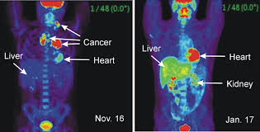
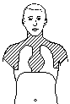
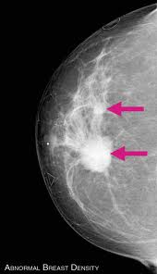
Radiation therapy can induce second cancers, including breast cancer
Ionizing Radiation (IR)
Hodgkin lymphoma
Remission
Second cancer

Slide 4
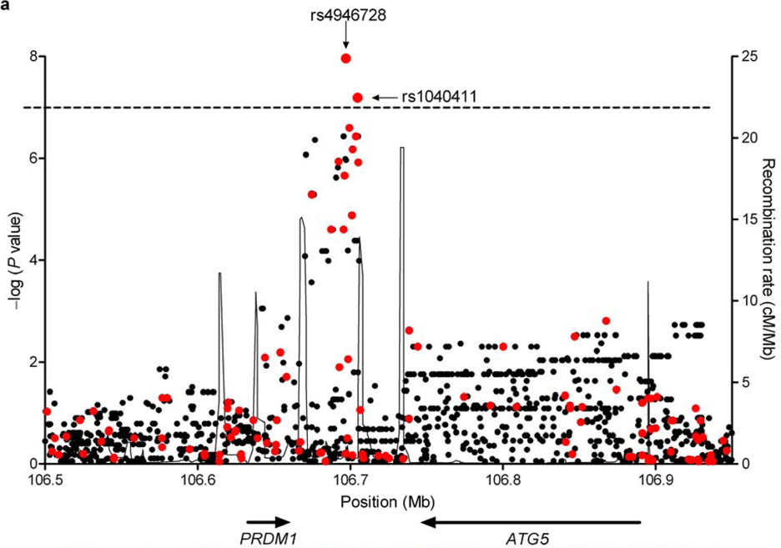
Genetic variants near PRDM1 are associated with radiogenic second cancers
2 SNPs intergenic between PRDM1 and ATG5 are significantly associated with radiogenic second cancers
Best et al 2011
Notes:
Cancer is a product of genes and environmental exposures. Usual limitation of GWAS – can’t control for past exposures that confound the study and obscure genetic effects.
Idea – by limiting study to cases/controls with common exposure, could increase power to detect genetic variants important in the context of that exposure

Slide 5
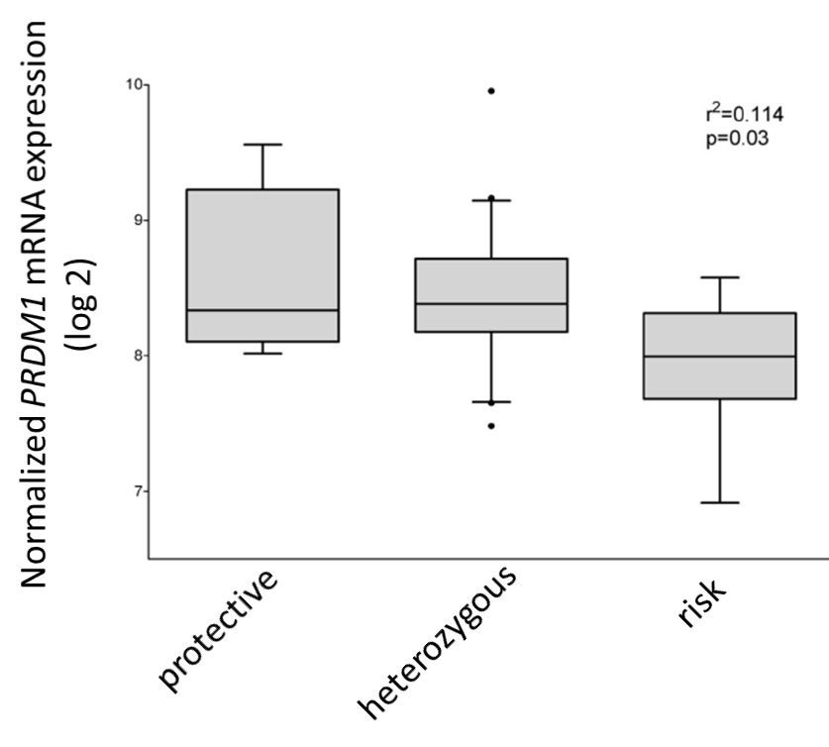
Variants associated with radiogenic cancer affect PRDM1 expression in LCLs
Adapted from Best et al 2011
Notes:
PRDM1 expression is higher in LCLs of the protective haplotype than the risk haplotype
Suggests PRDM1 confers protection against radiogenic cancers

Slide 6
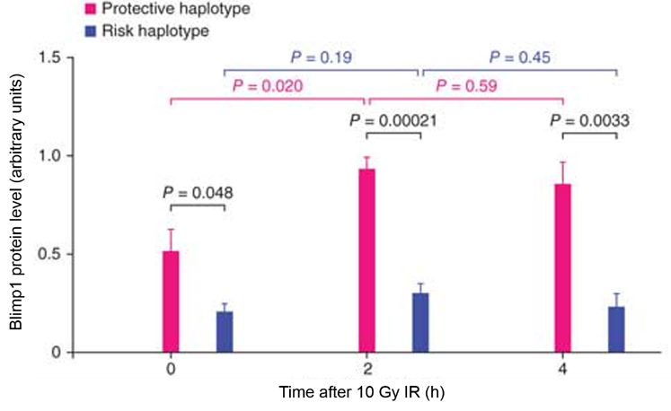
IR induces PRDM1 expression in a haplotype-dependent manner
PRDM1 protein level
(arbitrary units)
Adapted from Best et al 2011
Notes:
Suggests protective effect of PRDM1 haplotype could be mediated through Blimp1 induction after IR exposure
Effect of Blimp1 in the context of IR exposure may be what’s important

Slide 7
PRDM1 is a pleiotropic transcriptional repressor with context-dependent effects
Roles
Stress response
Termination of inflammation
Differentiation
Embryonic patterning
Mixed effects depending on context
Cell cycle arrest
Survival
Apoptosis
Differentiation

Slide 8
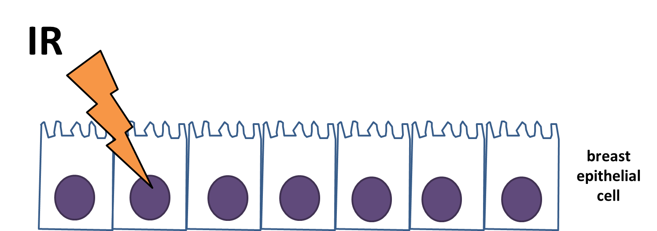
How does PRDM1 protect against radiation-induced cancer?
IR
DNA damage
mutation
transformation
Cell cycle arrest
Apoptosis
PRDM1

Slide 9
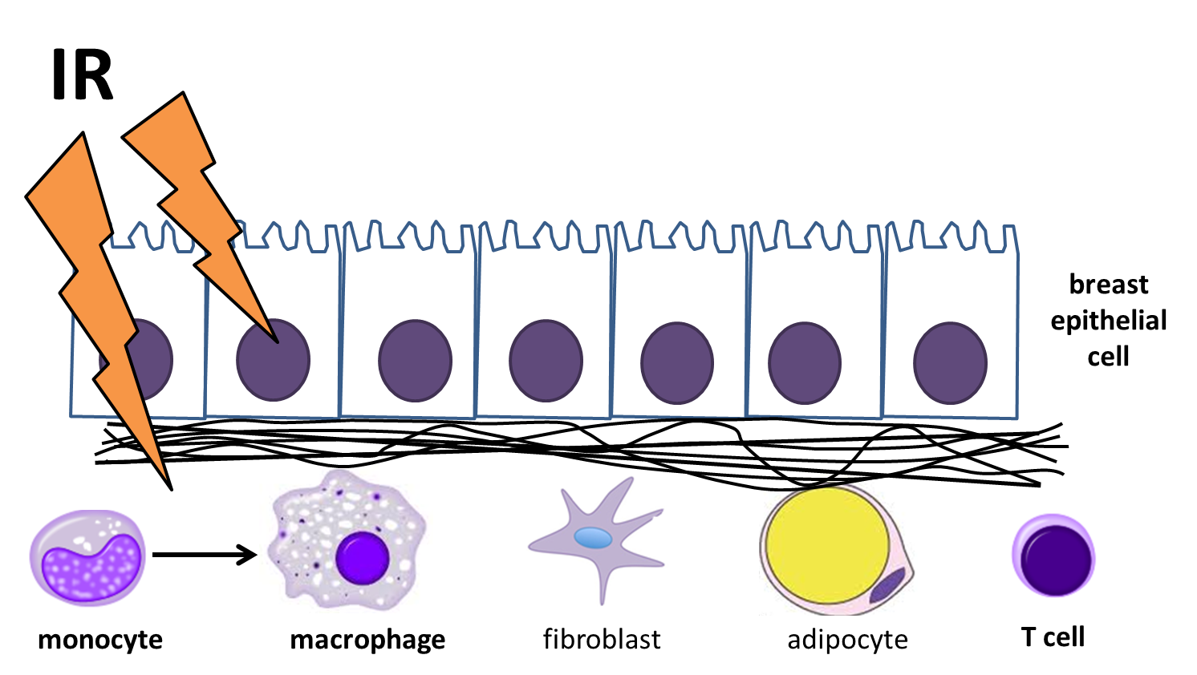
How does PRDM1 protect against radiation-induced cancer?
PRDM1
IR
Microenvironment reaction
transformation

Slide 10
How does PRDM1 induction by IR protect against radiogenic breast cancer?
In which breast-relevant cell types is PRDM1 induced by IR?
What mediates PRDM1 induction by IR?
What are the cellular consequences of PRDM1 induction by IR?
Does PRDM1 protect against radiogenic breast cancer in vivo?

Slide 11
How does PRDM1 induction by IR protect against radiogenic breast cancer?
In which breast-relevant cell types is PRDM1 induced by IR?
What mediates PRDM1 induction by IR?
What are the cellular consequences of PRDM1 induction by IR?
Does PRDM1 protect against radiogenic breast cancer in vivo?

Slide 12
Current hypothesis
PRDM1 expression is induced by IR in breast epithelial cells in a haplotype-specific manner

Slide 13

IR induces PRDM1 expression in breast epithelial cells with the protective haplotype
Hours after 5 Gy IR
-
0
0.5
2
4
6
8
24
p-ATM
PRDM1
actin
HCC1806 breast cancer cells
Also replicated in HCC1599 breast cancer cells
Notes:
So this is great news – IR induces Blimp1 in breast cells

Slide 14
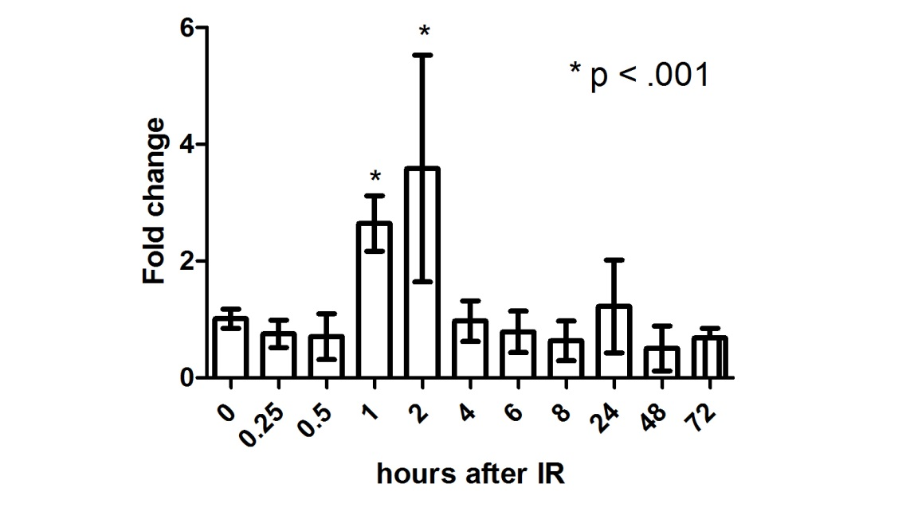
PRDM1 mRNA is induced by IR in breast cells with the protective haplotype
PRDM1α mRNA
HCC1806 breast cancer cells
5 Gy IR
Notes:
Consistent with the hypothesis of a transcriptional mechanism of induction
This isoform is the one known to be associated with stress responses

Slide 15
IR does not induce PRDM1 expression in breast epithelial cells with the risk haplotype
Hours after 5 Gy IR
0
0.5
1
2
4
6
8
24
p-ATM
PRDM1
actin
DU4475 breast cancer cells

Slide 16


PRDM1 is sensitive to a wide range of IR doses (0.1-10 Gy)
IR dose (Gy)
10
0
0.1
p-ATM
PRDM1
actin
HCC1806 breast cancer cells
4h after IR
Notes:
Interesting because 10cGy is the lowest dose at which mice have been shown to develop radiogenic breast cancer. So Blimp1 could be playing a role in regulating transformation for both low-dose and high-dose IR exposures

Slide 17
How does PRDM1 induction by IR protect against radiogenic breast cancer?
In which breast-relevant cell types is PRDM1 induced by IR?
What mediates PRDM1 induction by IR?
What are the cellular consequences of PRDM1 induction by IR?
Does PRDM1 protect against radiogenic breast cancer in vivo?

Slide 18
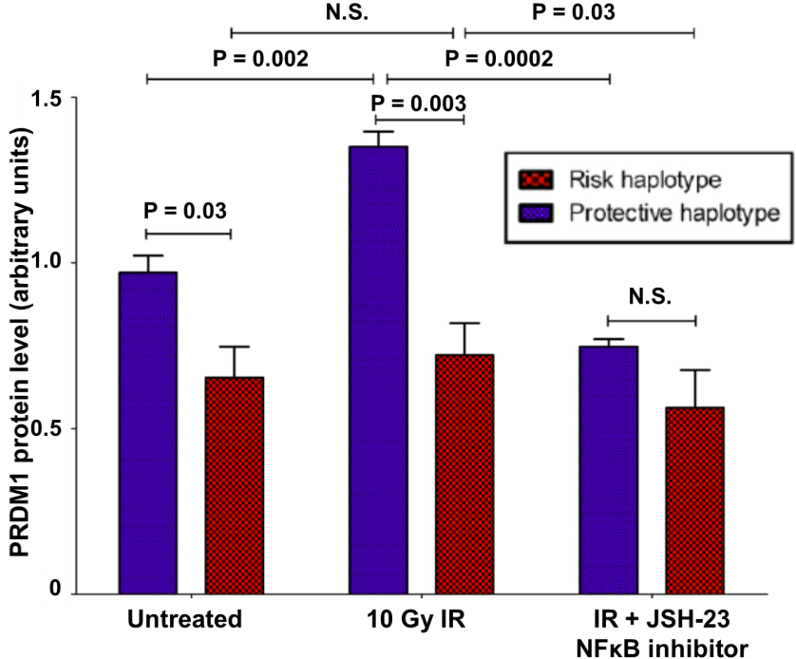
NFκB is a candidate regulator of PRDM1 induction by IR
NFκB is known to induce PRDM1 in response to a variety of stresses
IR induces NFκB signaling
In LCLs, NFκB inhibition blocks IR-mediated PRDM1 induction
Adapted from Best et al 2011

Slide 19
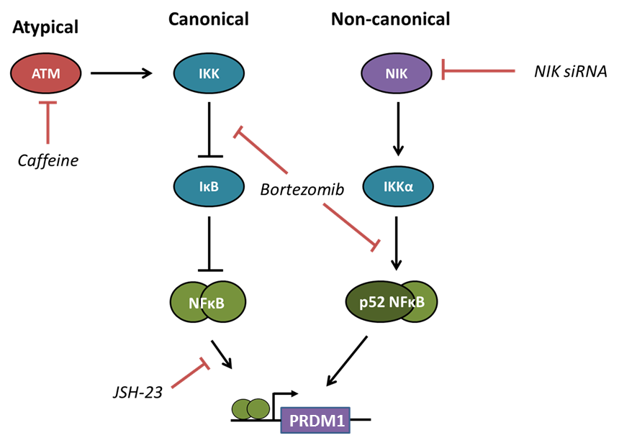
Strategy: test the role of NFκB in IR-mediated PRDM1 induction using NFκB inhibitors

Slide 20
How does PRDM1 induction by IR protect against radiogenic breast cancer?
In which breast-relevant cell types is PRDM1 induced by IR?
What mediates PRDM1 induction by IR?
What are the cellular consequences of PRDM1 induction by IR?
Does PRDM1 protect against radiogenic breast cancer in vivo?

Slide 21
3) What are the cellular consequences of PRDM1 induction by IR?
Cell cycle
PI staining
BrdU incorporation
Wild-type
PRDM1 shRNA knockdown
PRDM1
overexpression
Survival
Annexin V staining
Survival curves
Clonogenic assays?
Breast epithelial cell lines

Slide 22
How does PRDM1 induction by IR protect against radiogenic breast cancer?
In which breast-relevant cell types is PRDM1 induced by IR?
What mediates PRDM1 induction by IR?
What are the cellular consequences of PRDM1 induction by IR?
Does PRDM1 protect against radiogenic breast cancer in vivo?

Slide 23

4) Does PRDM1 protect against radiogenic cancer in vivo?
PRDM1^{+/-}
Speed congenics
PRDM1-flox
C57BL/6
PRDM1-flox
BALB/c
Mammary specific PRDM1^{-/-}

Slide 24
Acknowledgments
Cunningham lab
Aurelie Desgardin
Fangming Tang
Barry Sandall
Gabby Lapping-Carr
Jisu Shin
Holly Yang
Onel lab
Kate Wolak
Mark Sasaki
Eric Hungate
Imge Hulur
Sapana Vora
Others
Keston Aquino-Michaels
Robin Zhang
Vasa Trubetskoy
Mentors
Ken Onel
John Cunningham
Thesis committee
Geof Greene
Kay Macleod

